Slide 1



The Value of Tightly-Integrated Hydrologic and River-Operations Models on Water Resources Planning and Management
Eric Morway, NV WSC, Carson City, NV
Rich Niswonger, Earth Systems Modeling Branch, Menlo Park, CA
Enrique Triana, Research Triangle Institute, Fort Collins, CO
Wes Kitlasten, NV WSC , Carson City, NV
Steve Regan, Earth Systems Modeling Branch, Lakewood, CO
Murphy Gardner, NV WSC , Carson City, NV

Slide 2
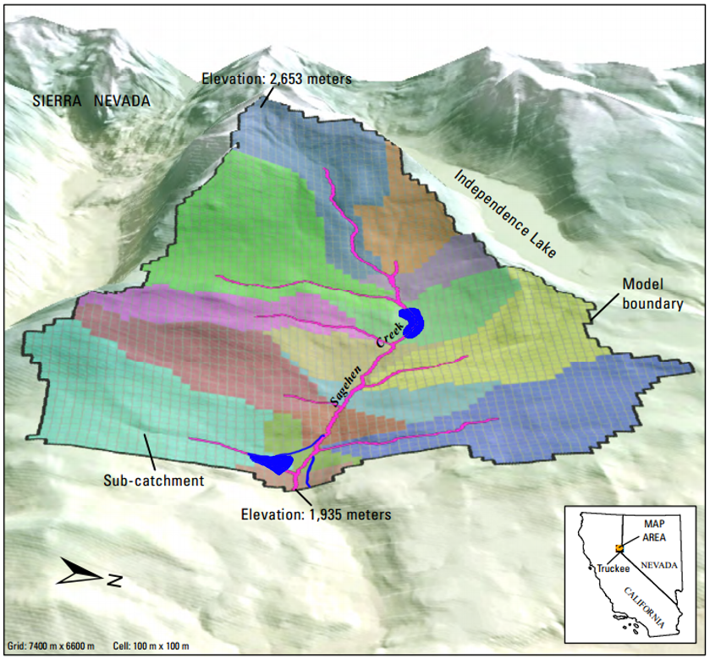
Sagehen watershed

Slide 3
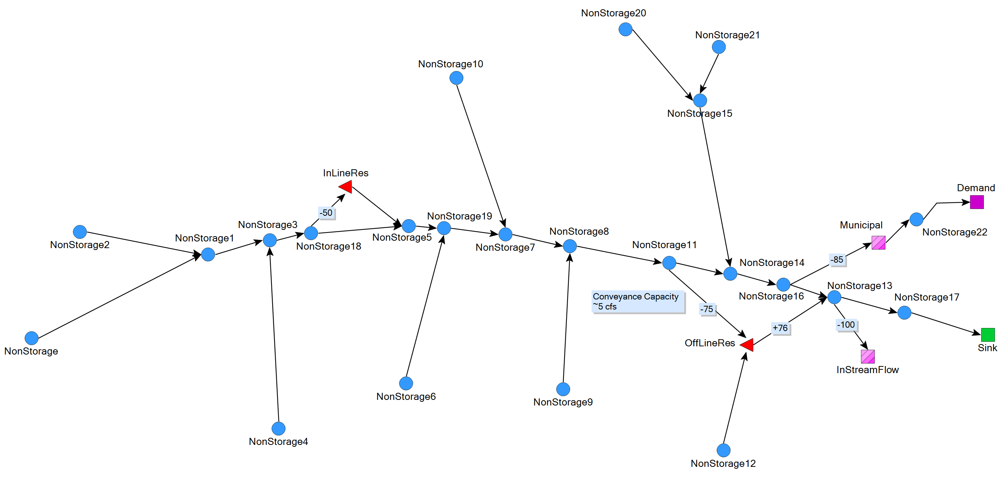
MODSIM VIEW of sagen

Slide 4
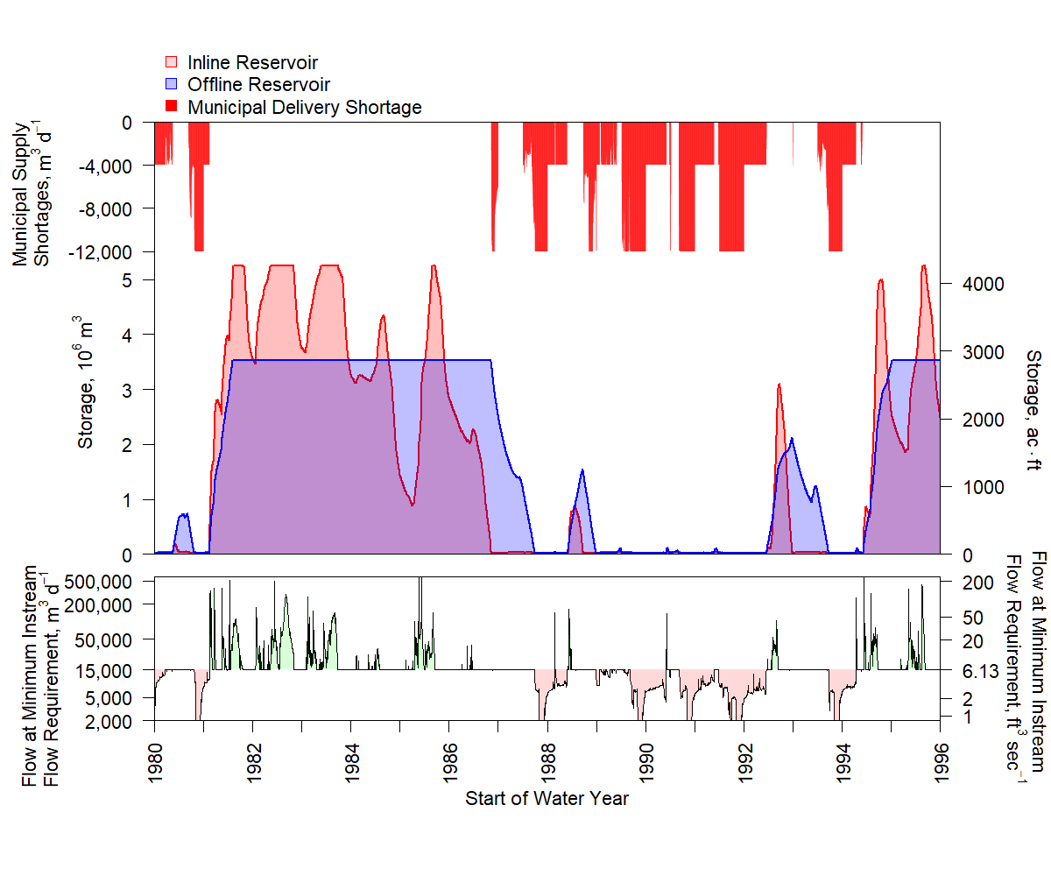

Slide 5
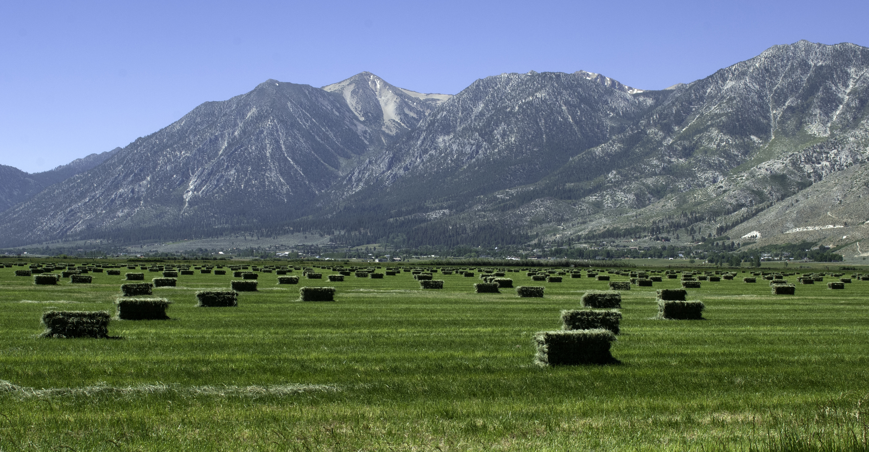
Carson Valley Application of MODSIM-GSFLOW
Notes:
A real-world application of the code to NW NV, a snowfed system

Slide 6
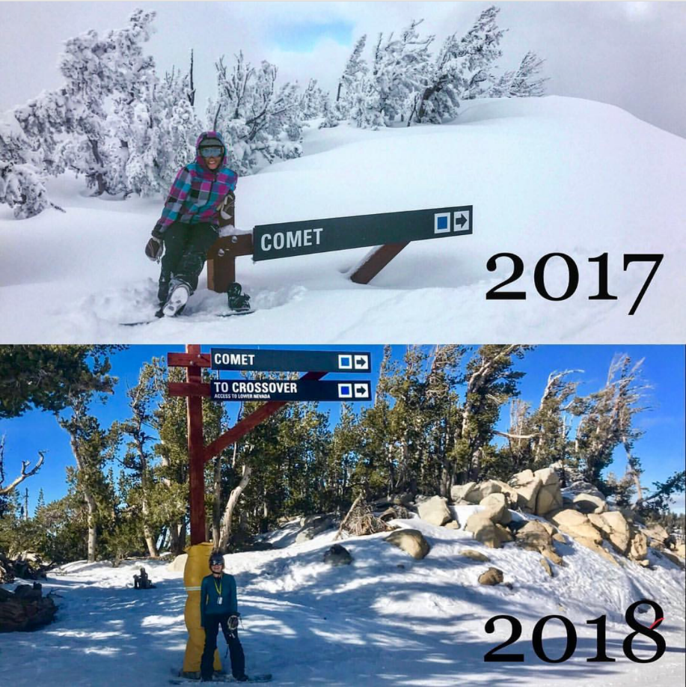

Slide 7
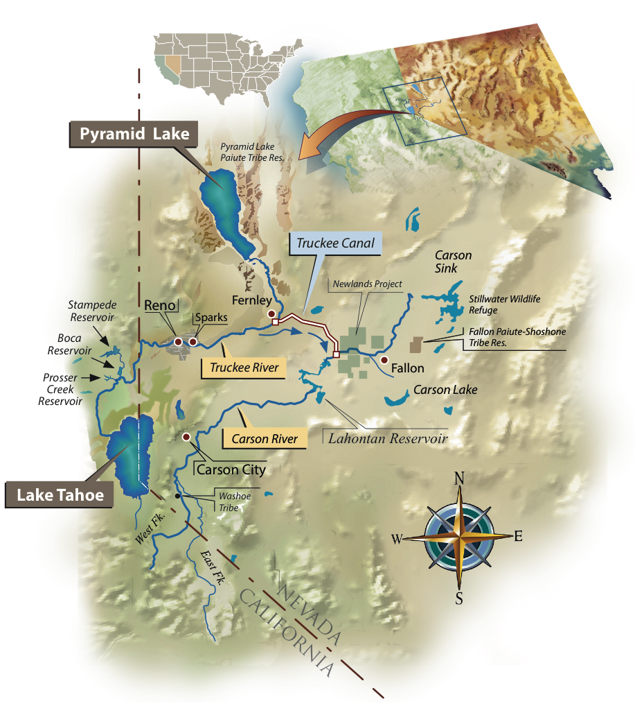
Investigate the impact of a changing climate on river operations
PRMS model of headwaters
PRMS model provides streamflow into integrated MODSIM-GSFLOW model of Carson Valley
Model scenarios consist of warming up the PRMS model and evaluating the impact on individual water rights
Design and Graphics by Kelley Sterle and Ron Oden, UNR
Notes:
Climate change is impacting the timing of runoff, and there is no upstream storage. Hence, as more precipitation falls as rain, or snowmelt occurs earlier, the available water won’t be available when it is needed, it will have already flowed downstream.

Slide 8
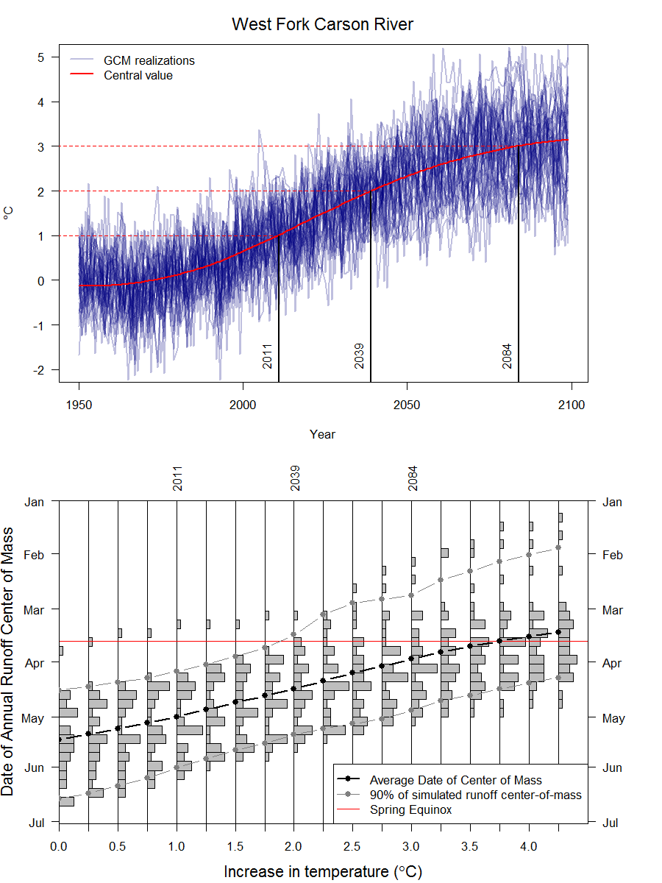
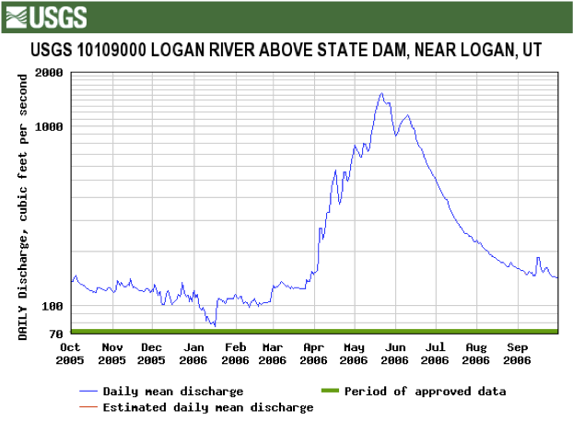
Center-of-mass of 50% of total annual runoff for different levels of warming
2011
2039
2084
2011
2039
2084
Notes:
Stakeholders wanted us to use historical climate (temperature/precip) record.
This timing issue more than highlights the need for an integrated hydrologic-operations model, but more importantly, highlights the need to consider and potentially start implementing pilot studies that include Managed Aquifer Recharge, or others that you the stakeholders find collective agreement on. Note from Eric after 2/20/2018 SAG: In future presentations of this work, I think it should be stated explicitly (somehow highlighted, anyway), that a key feature of the integrated model is that it has no hard-wired diversions, and that is what ‘allows’ the water to make it through to Lahontan. That is, I think it is clear in our minds because we know the model so well, but I’m not sure this link is made in the minds of the stakeholders. So for example, when discussing the plot shown to the right, what we need to then point out is, “look, the operation model is not going to tap into the earlier hydrograph because it is going to first honor the alpine decree’s start-of-the-irrigation season start date.” The stakeholder’s immediately recognize that this is how it works out in reality, but there is no model prior to MODSIM-MODFLOW that could do this on the fly and in priority.

Slide 9
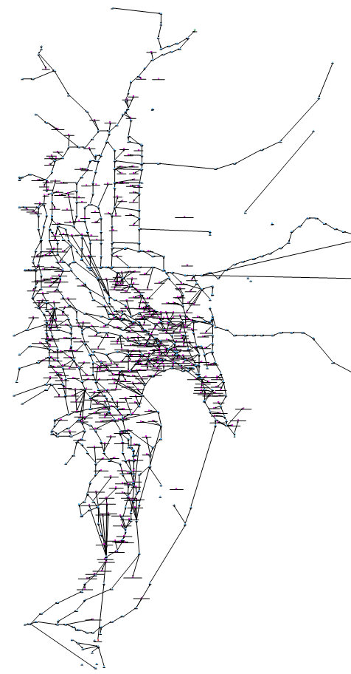
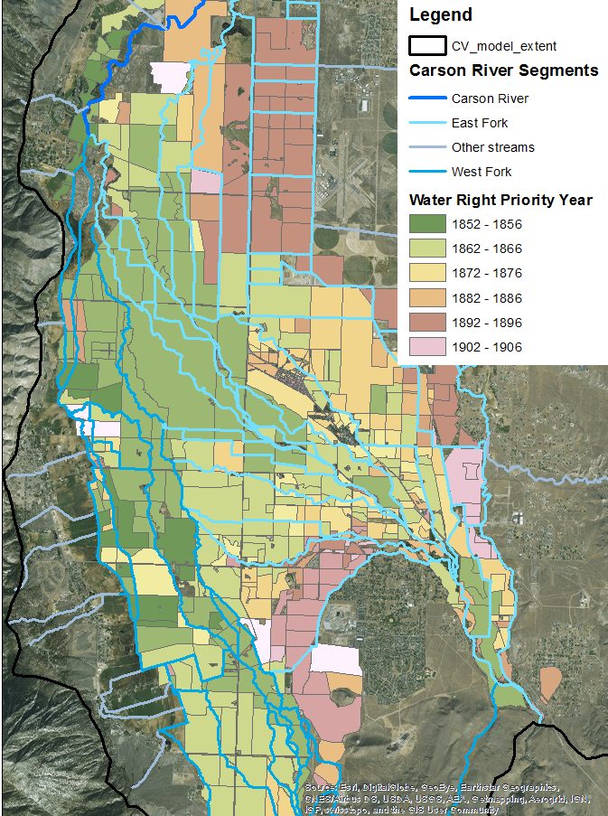
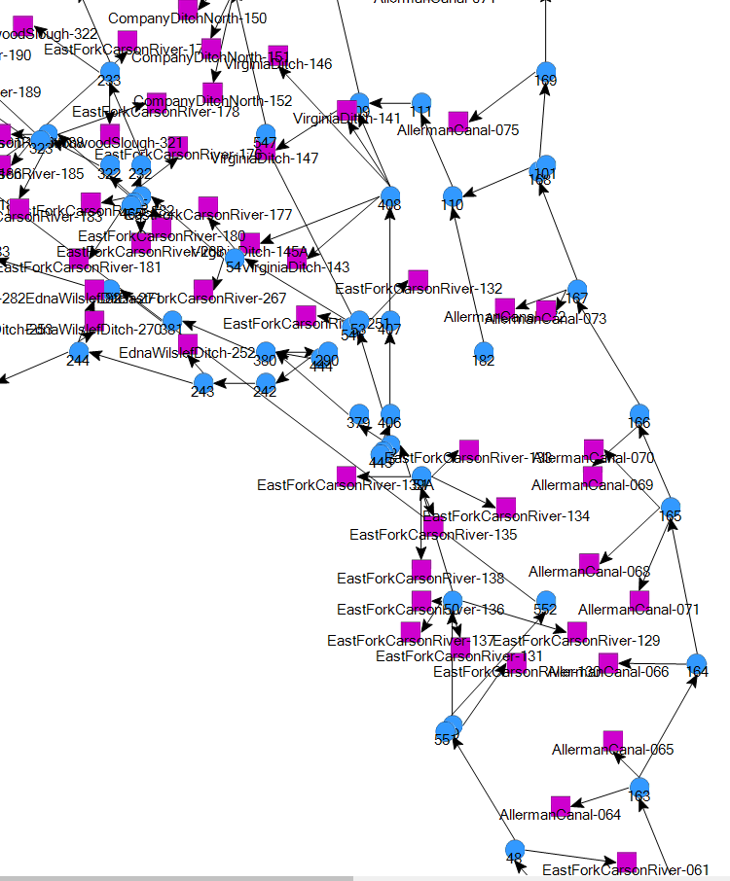
MODSIM http://modsim.engr.colostate.edu/
Carson River Operations Model
Return Flows
Notes:
Our model accounts for the Alpine Decree framework (Digital representation of the Alpine Decree)
Decree date, Allerman Split, Reservoir operations. The integrated code allows us to “…” (Don’t make aggressive statements like “we couldn’t do such-and-such without the integrated code.”) We’re resolving down to the individual water right level, which is critical for getting stakeholder involvement. By getting it down to this level, stakeholders are engaged.
Also note the incredible amount of spatial heterogeneity in the spatial distribution of water rights. As return flows get plugged back into the surface-water (MODSIM) network by the hydrology model, they will be routed to the next senior-most water-right that is possible to deliver to.

Slide 10
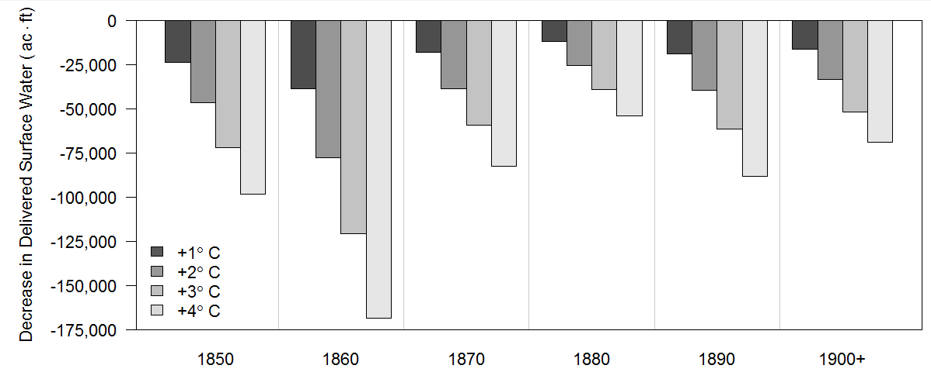
Total Delivery – All Decades
Simulations for 1980-2015
All Results are differenced from Historical +0C
Seniority
Water Right Decree Date by Decade
Notes:
1. clear-up up x-axis
2. A lot of uncertainty in climate. If only 1 deg of warm-up, what is the impact
3. The pre-conception by senior water right holders is that future climate is going to affect them by virtue of the fact they are most senior. This shows, for the first time, that even the senior water right holder are in fact impacted. Why are the senior water right holder seemingly impacted the most? Then explain…

Slide 11
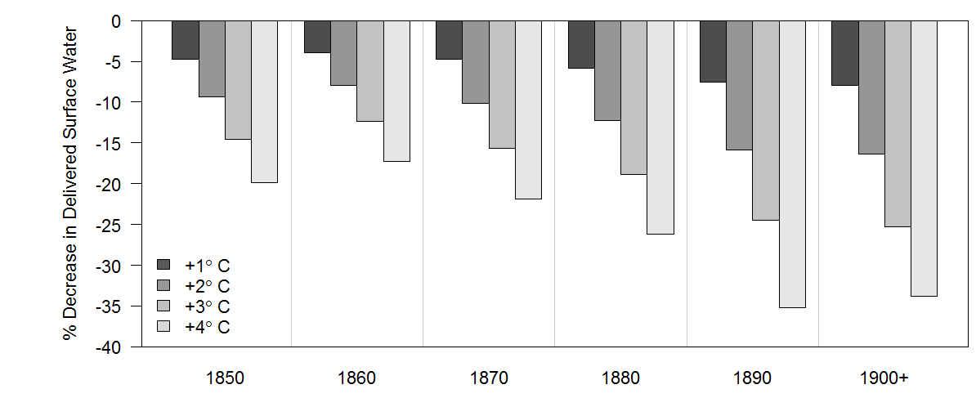
% Change in Delivery – All Decades
Seniority
Water Right Decree Date by Decade

Slide 12
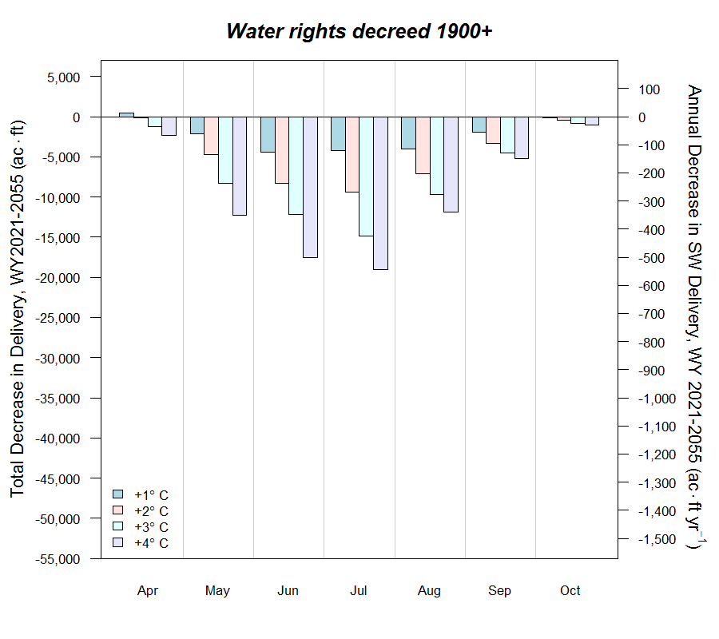
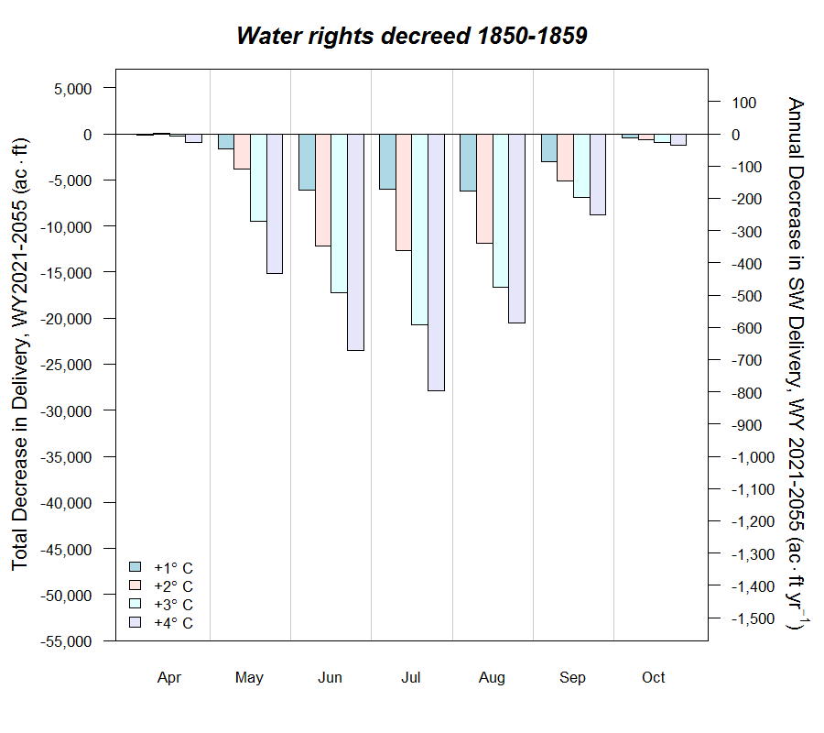
Total Delivery – first/last decade of decreed WRs
Notes:
We can show seasonal as well.

Slide 13
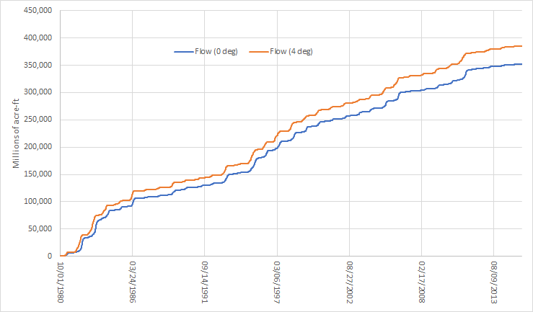
Cumulative Flows at Ft. Churchill
Average increase of 20,000 acre-ft per year of water flowing to Lahontan
Tens of Ac*ft
Irrigation season
Notes:
“I know what you are all thinking, where did all that water go?” This water went by the growers and went downstream. It wasn’t consumptively used, Who benefits, the folks

Slide 14
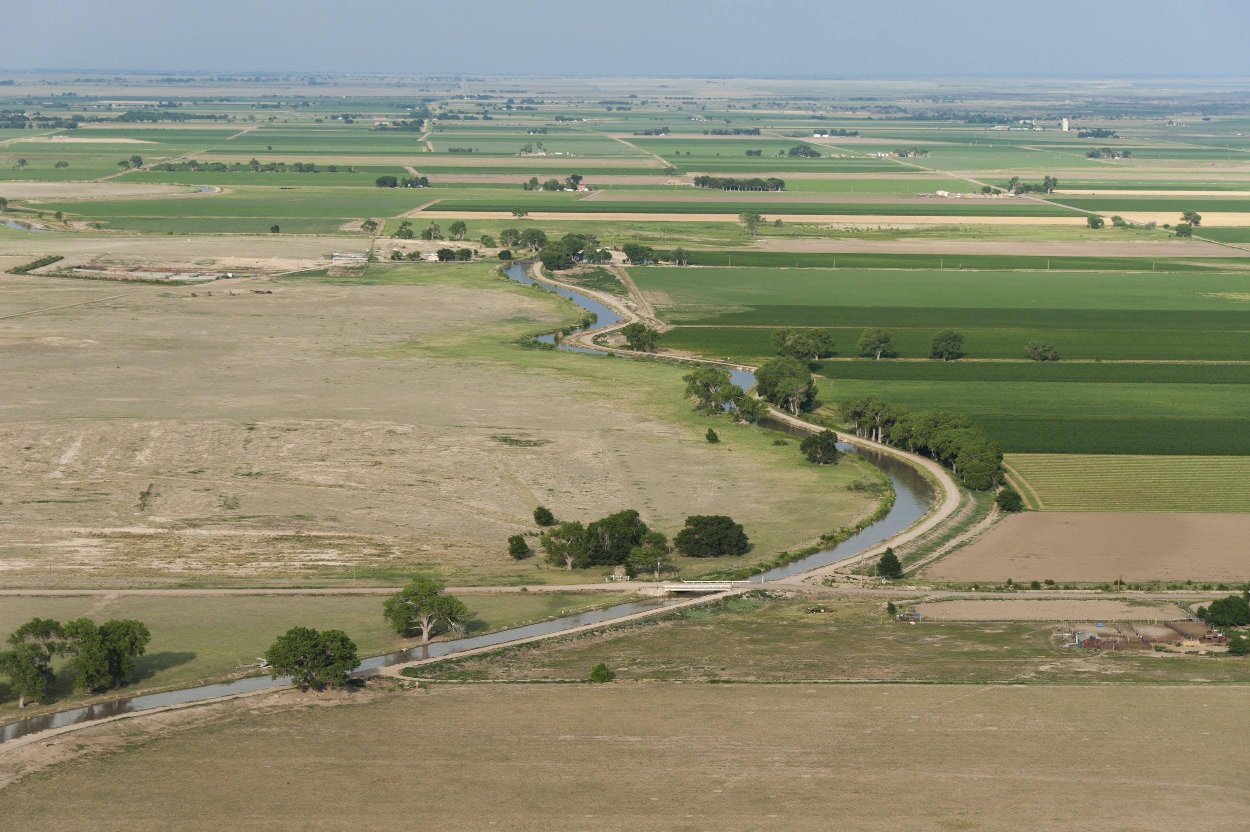
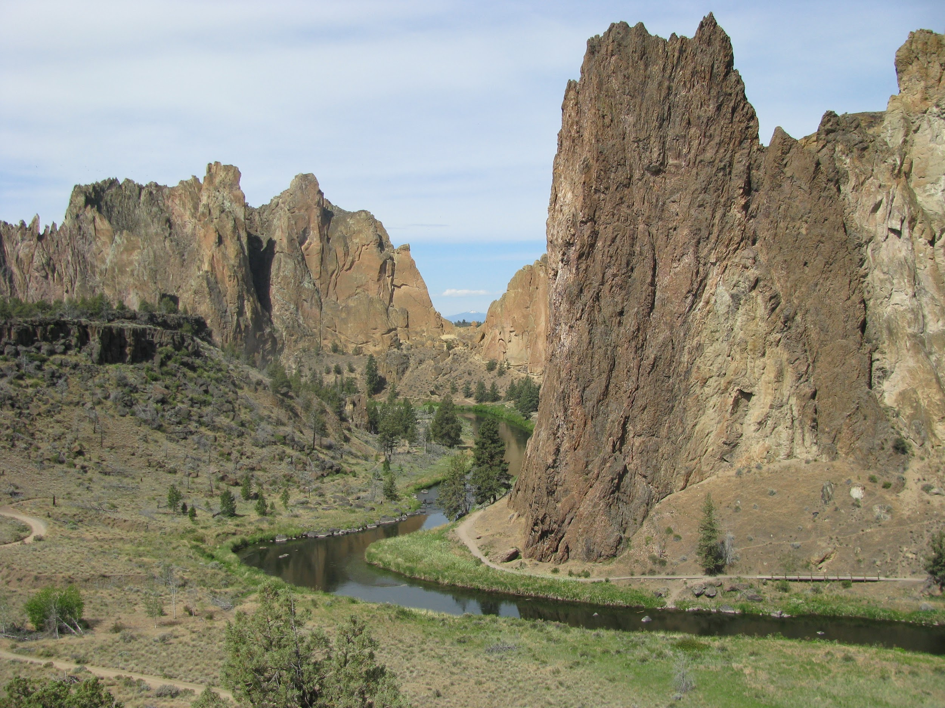
Applications
MODSIM-MODFLOW theory and description [published in EMS]
Agricultural Managed Aquifer Recharge (Ag-MAR) [published in WRR]
Carson Valley, NV [in development]
Russian River Basin, CA [in development]
Deschutes River Basin, OR [in development, integrating existing models]
Walker River?
Other western basins
Crooked River, Deschutes Basin, OR
Notes:
Walker is a great example of getting non-intuitive results that only could get from a full model, simplied models will not work in a case like this.
There are a lot of these models already out there and they just need integration for a more powerful tool. Developing on established and widely applied codes.

